Slide 1

The Drive for Improvement
Employee Analytic Report

Slide 2
Quote that reflects this approach… “ It's a small step towards progress, but a significant leap for overall performance. .”
quote

Slide 3
ACTION
The employee satisfaction and performance is below the company’s average rating
We have identified the drive for improvement to elevate it to a higher level

Slide 5
Objectives
Understand Employee Demographics: Analyse age, gender, and department distribution
Performance and Satisfaction Analysis: Examine how performance ratings correlate with satisfaction scores.
Attrition Patterns: Identify factors contributing to employee attrition.
Salary Insights: Investigate salary distribution on and its relationship with job roles and departments.
Years of Service: Assess the impact of years of service on performance, satisfaction, and attrition

Slide 6
Summary
The total number of Employee
780
The total number of Active Employee
546
The total number of Attrition
264
Attrition
30%

Slide 7
Age
The highest number of employee are within 31– 35yrs

Slide 8
Department
Out of the 6 departments, sales has the highest number of employee with 157 while engineering is the lowest with 105.

Slide 9
Gender
The company has more males (58%) than females (42%).

Slide 10
Performance
The highest number of 246 staffs performed average

Slide 11
Satisfaction
The highest satisfaction among employee is average with 364 staffs

Slide 12
Attrition
The attrition rate is 30% which represent 234 employees

Slide 13
Salary by department
The Marketing department has the highest average salary of 63,224

Slide 14
Salary by role
The specialist role has the highest average salary of 64,341

Slide 15
Average year of service by average year of rating
The highest is good with 8.5 and 9.0 for average year of service and year of rating

Slide 16
Demography – Age
Insight
Row Labels | Total Employee | Total Employee %
26-30yrs | 228 | 29.2%
31-35yrs | 292 | 37.4%
36-40yrs | 180 | 23.1%
Grand Total | 700 | 89.7%
Approx. 90% of the workforce are between ages 26-40.
The employees are mostly young people and young adult, up to midlife ages.
Mostly married, career and income minded.

Slide 17
Demography – Gender
Insight
Imbalance recruitment and retention of female

Slide 18
Performance
Insight
Row Labels | Count Of Employee | Performance Range %
Poor | 135 | 17.3%
Below Average | 176 | 22.6%
Average | 246 | 31.5%
Grand Total | 557 | 71.4%
Approximately 71% of Employees Performed Below Average

Slide 19
Satisfaction
Insight
Average Satisfaction Rating is 3.8

Slide 20
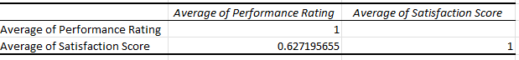
Satisfaction
Insight
Row Labels | Average of Performance Rating | Average of Satisfaction Score
EN | 7.3 | 3.9
FN | 6.7 | 3.9
HR | 6.6 | 3.7
IT | 6.8 | 3.7
MK | 6.7 | 3.8
SL | 6.8 | 3.7

Slide 21
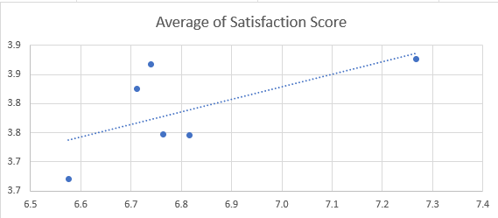
Satisfaction
Insight
There is a strong positive correlation of 0.63 between performance ratings and performance scores. This implies that both have strong relationship together and as performances scores increases, the performance rating may increases

Slide 22
Attrition
Insight
Performance - Poor job satisfaction

Slide 23
Attrition
Insight
Salary - Inadequate compensation

Slide 24
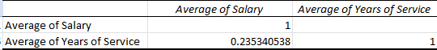
Salary
Insight
Row Labels | Average of Salary | Average of Years of Service
Specialist | 64,341.3 | 6.1
Manager | 61,786.4 | 7.6
Engineer | 61,561.1 | 6.8
Sales Rep | 58,177.4 | 5.7
Accountant | 58,048.8 | 7.0
Analyst | 57,435.5 | 6.0
Grand Total | 60,953.8 | 6.4

Slide 25
Salary
Insight
There is a weak positive correlation of 0.25 between average salary and average year of service. This implies although salary tends to increase as year of experience increases but the relationship is not very strong

Slide 26
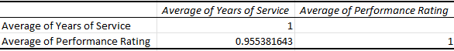
Year of service
Insight
Row Labels | Average of Years of Service | Average of Performance Rating
Above Average | 8.4 | 8.0
Average | 6.4 | 7.0
Below Average | 5.0 | 6.0
Good | 8.5 | 9.0
Poor | 4.9 | 5.0
Grand Total | 6.4 | 6.8

Slide 27
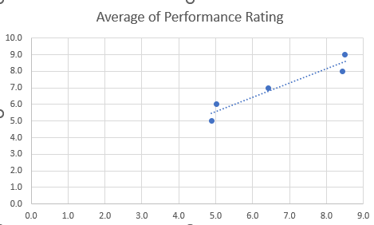
Year of service
Insight
There is a very strong positive correlation of 0.96 between average years of service and performing rating. This implies that as years of services increases then the performing rating may increases

Slide 28
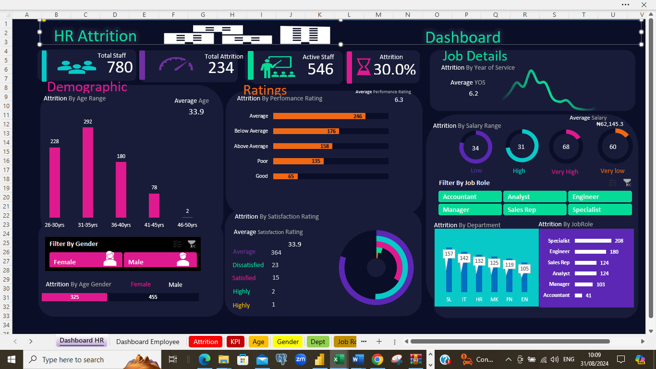
Insight

Slide 29
Insight

Slide 30
Recommendation
Implement succession planning to ensure smooth leadership transitions and future readiness.
Promote age diversity across all departments to foster innovation and inclusivity.
Enhance workforce engagement by involving employees in decision-making and recognizing their contributions.
Address potential gaps in skills, leadership, and resources through proactive planning and analysis.
Review hiring practices to ensure they align with gender balance and attract top talent.
Establish support and development programs to help employees grow and advance in their careers.
Introduce performance improvement programs to elevate productivity and address underperformance.

Slide 31
Recommendation
Provide ongoing training and development to keep employees' skills current and relevant.
Analyse and address root causes of issues to prevent recurring problems and improve processes.
Promote best practices across departments to ensure consistency and efficiency.
Conduct regular salary benchmarks to maintain competitive and fair compensation structures
Conduct exit interviews to gather valuable feedback and identify areas for improvement.
Foster cross-training and job rotation to increase versatility and employee satisfaction.

Slide 32
Q/A

Slide 33
Presented By Taiwo Ige 08067201865 Thank You

